Slide 1



Article 50:
View from UK and EU27
April 2017

Slide 2
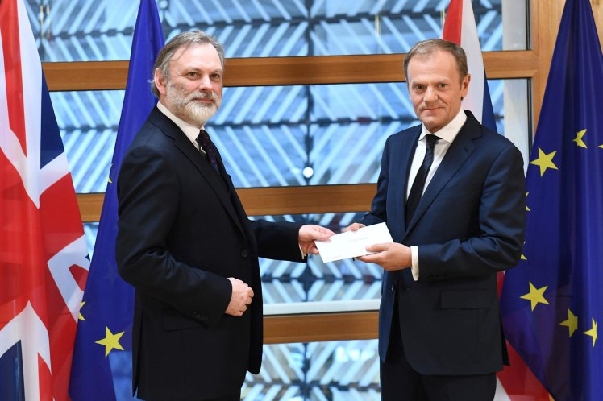

Brexit: No Turning Back

Slide 3
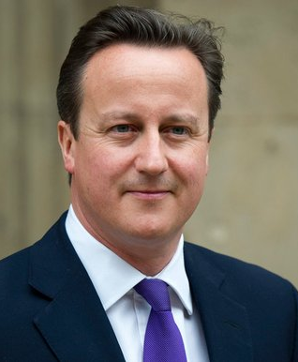
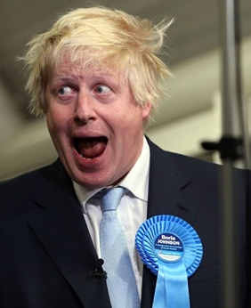
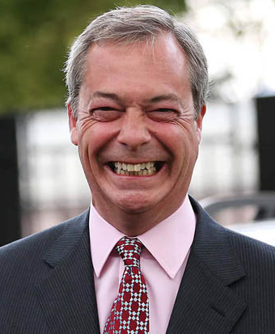
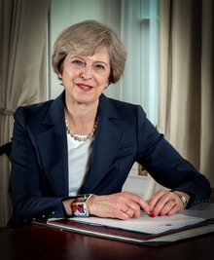
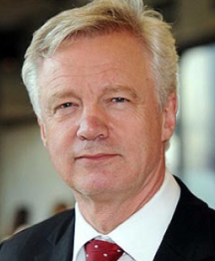

The Grown-ups Are
Back In Charge
2016
2017

Slide 4
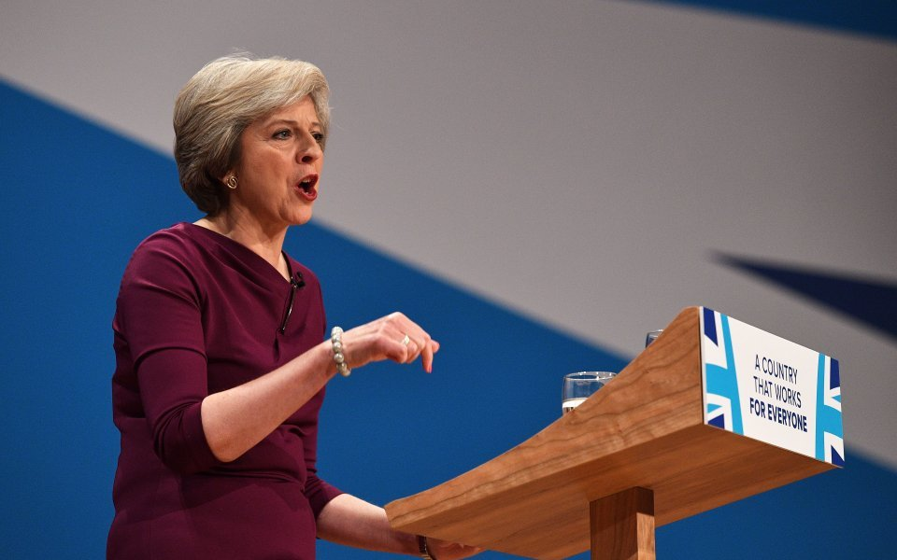
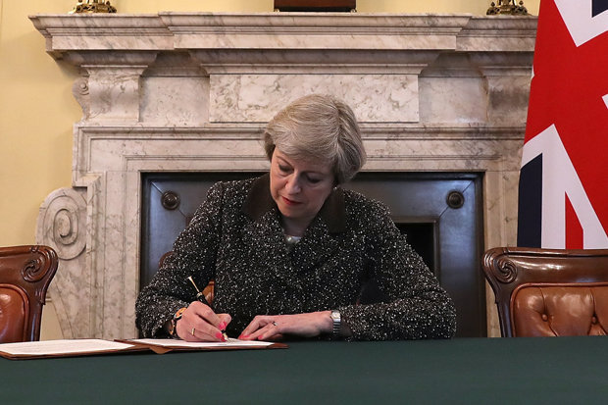
Talking Hard Brexit
Seeking Soft Brexit

Slide 5
Divorce Is A Messy Business
Terms of Departure
Ending the UK’s contribution to the EU budget and winding down spending programmes in the UK.
Division of assets and pension liabilities.
Acquired rights, healthcare and other social obligations for nationals living in other Member States.
Residence status of EU nationals living in UK, and UK nationals living in EU.
Border arrangements – Northern Ireland, Gibraltar.
Extent to which UK can “cherry pick”.
Trade Negotiations
UK willingness to make a financial contribution to the EU budget in return for market access concessions.
Passporting and financial services.
Terms of any Free Trade Agreement and Customs Agreement.
“No country can get a better deal outside the EU than inside.”
Length of time it could take to negotiate a deal – requires support from remaining 27 Member States.
Defence and security commitments.

Slide 6
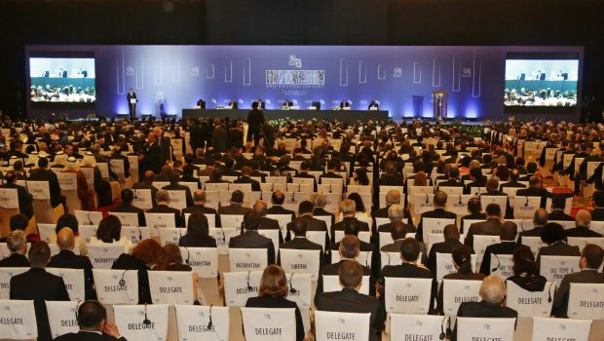

Is No Deal Better Than a Bad Deal?
  WTO rules would be the least integrated economic relationship the UK could have with the EU.
  Under the WTO, the UK and EU would be subjected to external tariffs on imports, with no customs agreement.
  No deal a potentially chaotic and disruptive outcome: “breakdown in supply chains, chaos at Dover as customs controls are introduced, a serious disruption in air traffic.”
  HM Treasury – “Relying solely on WTO rules would result in a significant reduction in the openness of the UK economy to the outside world. It would be the alternative with the most negative long term impact on both sides.”

Slide 7
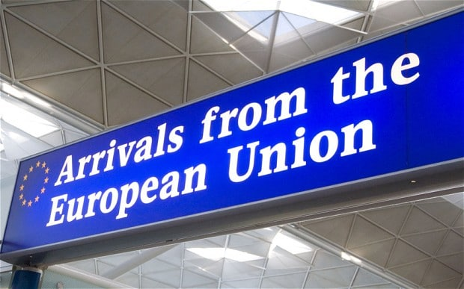

Migration & Free Movement
  Control of migration the major factor in the referendum result.
  Home Secretary Amber Rudd – “We are ending free movement as we know it.”
  Key priority – status of EU nationals resident in UK, and UK citizens living in other Member States.
  Questions to be resolved include entry requirements and rules for short term movement into and out of UK, and requirements for those living to live or work in the UK longer term.
  Immigration Bill to be published before 2019.
  Chancellor Philip Hammond has suggested a relatively liberal arrangement. Possible special status for EU nationals.
  Concerns for tourism sector.
  ETIAS – “European ESTA” system. Will British visitors to Europe be required to go through this process?

Slide 8

Scotland
  Potential referendum on Scottish independence in late 2018 or early 2019.
  On 28th March, Scottish Parliament voted by 69-59 votes.
  May’s view – Second referendum only possible after March 2019, once Brexit negotiation process completed.
  Barroso doctrine – Any country that secedes from a Member State loses its EU membership as well.
  Referendum unlikely to be held in time prior to UK’s formal departure from EU.
  Choice will therefore be for Scotland to remain in a UK outside the EU, or to leave the UK and seek new EU membership from outside.

Slide 9
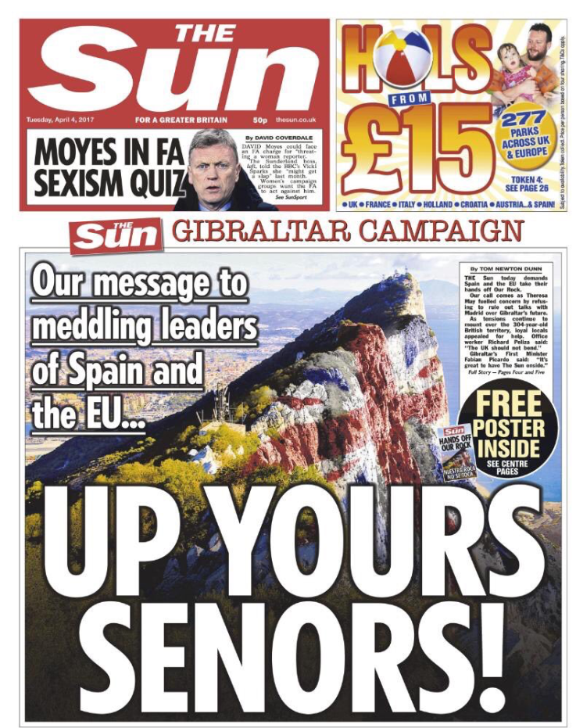
Media Climate

Slide 10
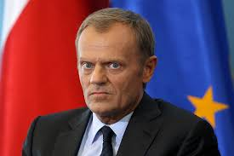
The Approach of the EU 27
“Orderly withdrawal” because “Brexit itself is punitive enough”.
Notes:
Talk of hard Brexit and soft Brexit is lost in Brussels where there is only hard Brexit on offer.
Council mood in the immediate aftermath was sober and business like keen to ensure stability. A deal is not closed off but is contingent on several factors which we’ll come onto in a moment.

Slide 11
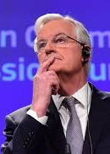
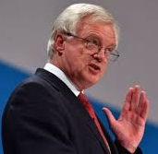
Negotiating Guidelines For Exit
Budget commitments and citizens’ rights come first
“Sufficient progress” needed before trade talks begin.
Citizens’ rights must be reciprocal, enforceable, non-discriminatory and apply at the date of exit.
Single market access = four freedoms.
However, “Bridges” possible
Notes:
Order of discussions rather than agreement since article 50 is agreed at the end not incrementally.
Sufficent progress: judgement is therefore political and not legal
A deal is possible.
Enforceable suggests some role for the CJEU in arbitrating on this post-Brexit, problematic for the UK.
Non-discriminatory so the UK will have to accept Romanian road sweepers as well as Danish doctors.
Four freedoms are a package so if single market access is to be prolonged as part of a transitional deal then that’s warts and all. No having access while limiting freedom of movement for example.
However, the guidelines talk about bridges which suggests that the UK could gradually phase out to avoid a cliff edge when it leaves.

Slide 12

The Future Relationship
Any future relationship must be different
Single market off the table
No fiscal, social and environmental dumping.
Spain must approve application to Gibraltar
Notes:
If you’re out you’re out and there can be no possibility to replicate EU membership from outside the club.
This is even the case on a sectoral basis so special deals for individual sectors like financial services look unlikely.
A big concern for Member States which have reacted defensively to the idea that the UK could aggressively cut tax and regulation to attract inward investment on the shores of Europe. Although the chances of this happening in the short term while the UK looks for a new trade deal seem unlikely.
The EU has cleverly put the issue of Gibraltar to one side giving Spain a veto right on the application of a new deal to Gibraltar.

Slide 13
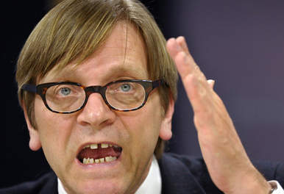
The European Parliament: Bad Cop
A time limit of 3 years on any transitional deal which should be limited in scope.
The European Court of Justice (ECJ) will be responsible for settling any legal challenges during the transition period.
No UK attempts to negotiate free trade deals with other countries while it is still an EU member state.
“Full involvement” of the European Parliament
Notes:
While the Council is sober, the Parliament is belligerent. It will prove to be an irritant for the UK in these negotiations.
In fact the financial services sector is pushing for two transitional deals – one until an agreement is struck and then one before it applies. Strict limitations like this will disappoint.
Another difficult one for the UK. The status of the ECJ has become symbolic so any effort to extend its influence will be resisted.
This is likely to create some flashpoints over the next couple of years with the UK keen to show that it is open for business post-Brexit.
Parliament will flex its muscles as much as possible. Its line will not be followed slavishly but it has influence over the process and will leverage that as much as possible.

Slide 14
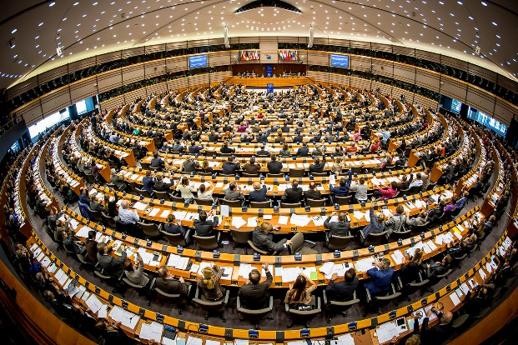
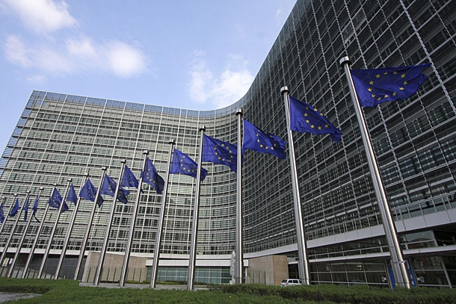
Key Dates
  Publication of Great Repeal Bill – May 2017
  UK Parliament will vote on the final deal – later 2018
  Possible – but unlikely – date for Scottish independence referendum – Late 2018
  European Parliament must consent to the withdrawal agreement by a simple majority – Early 2019.
  Council of the EU (minus UK) must agree to withdrawal deal by qualified majority – Early 2019.
  UK’s stated aim for any transitional agreement to be a short term arrangement – European Parliament has suggested three years.
  UK formally leaves the EU – March 2019

Slide 15
Conclusions
A deal is possible and probable
A new relationship could be defined quicker than expected
There are opportunities for companies that are on the front foot

Slide 16
Article 50:
View from UK and EU27
April 2017

